Slide 1
Whether the weather be wet…
“One of the things Ford Prefect had always found hardest to understand about human beings was their habit of continually stating and repeating the obvious, as in It's a nice day, or You're very tall, or Oh dear you seem to have fallen down a thirty-foot well, are you alright? At first Ford had formed a theory to account for this strange behaviour. If human beings don't keep exercising their lips, he thought, their mouths probably seize up. After a few months' consideration and observation he abandoned this theory in favour of a new one. If they don't keep on exercising their lips, he thought, their brains start working. After a while he abandoned this one as well as being obstructively cynical and decided he quite liked human beings after all, but he always remained desperately worried about the terrible number of things they didn't know about.” – Douglas Adams (1979), The Hitchhiker’s Guide to the Galaxy

Slide 2
Whether the weather be wet Or whether the weather be hot We’ll weather the weather Whatever the weather Whether we like it or not!
Anonymous
(I’m Andrew Trotman)

Slide 3
Christmas 2013

Slide 4
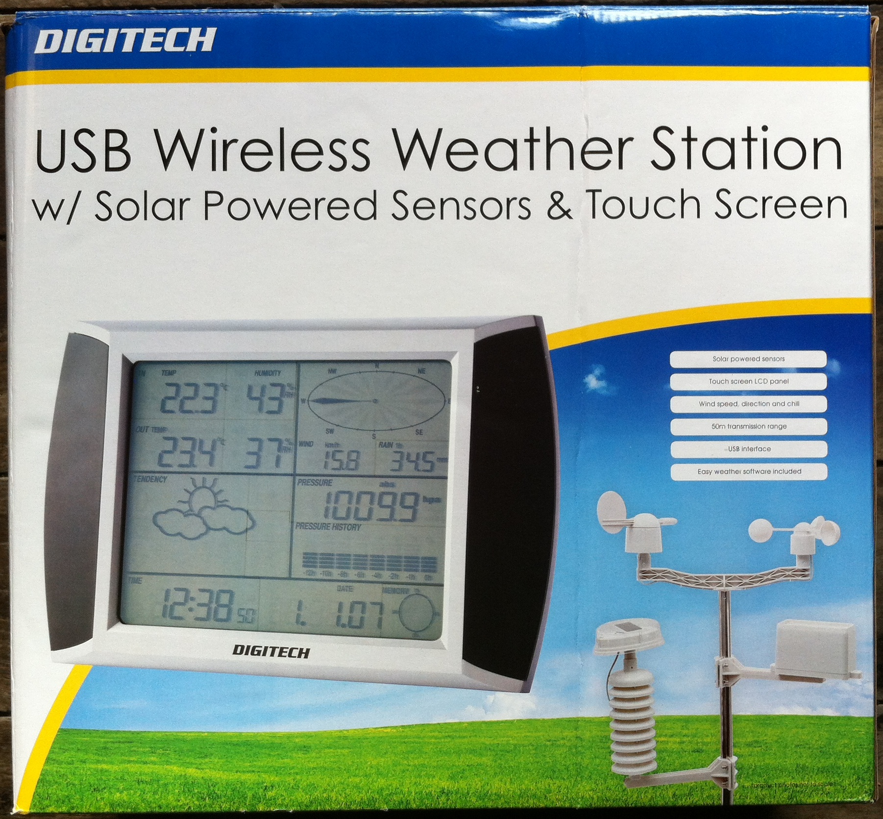
USB Wireless Weather Station

Slide 5
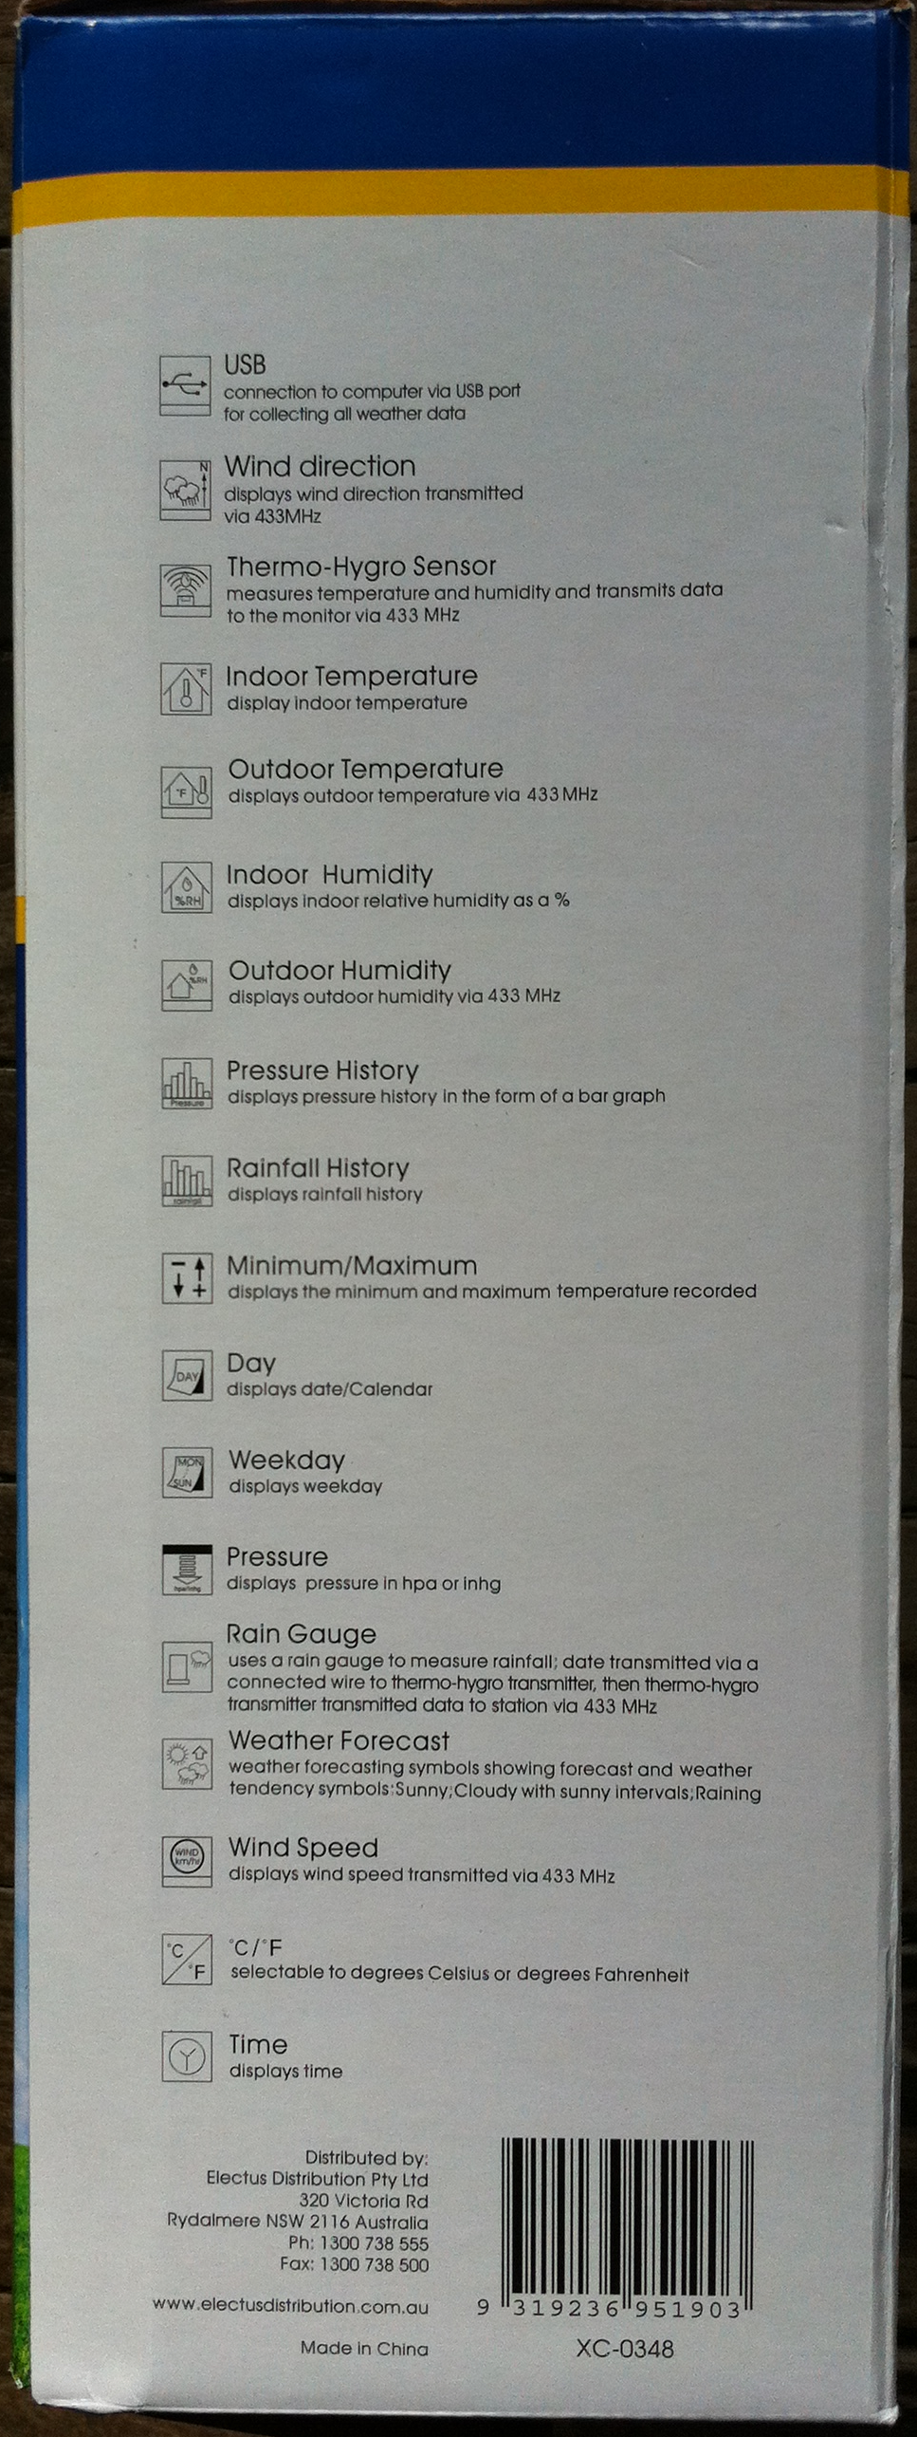
USB Wireless Weather Station
Temperature
Humidity
Cumulative rainfall
Wind speed
Wind direction
Absolute air pressure

Slide 6
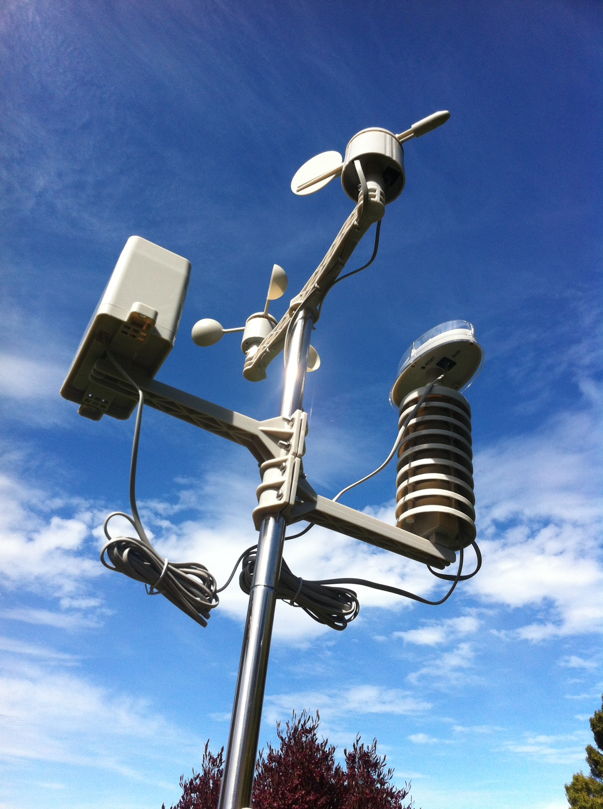
Remote Sensor
Vane
Pluviometer
Anemometer
Photovoltaic
Thermometer
Hygrometer
Transmitter

Slide 7
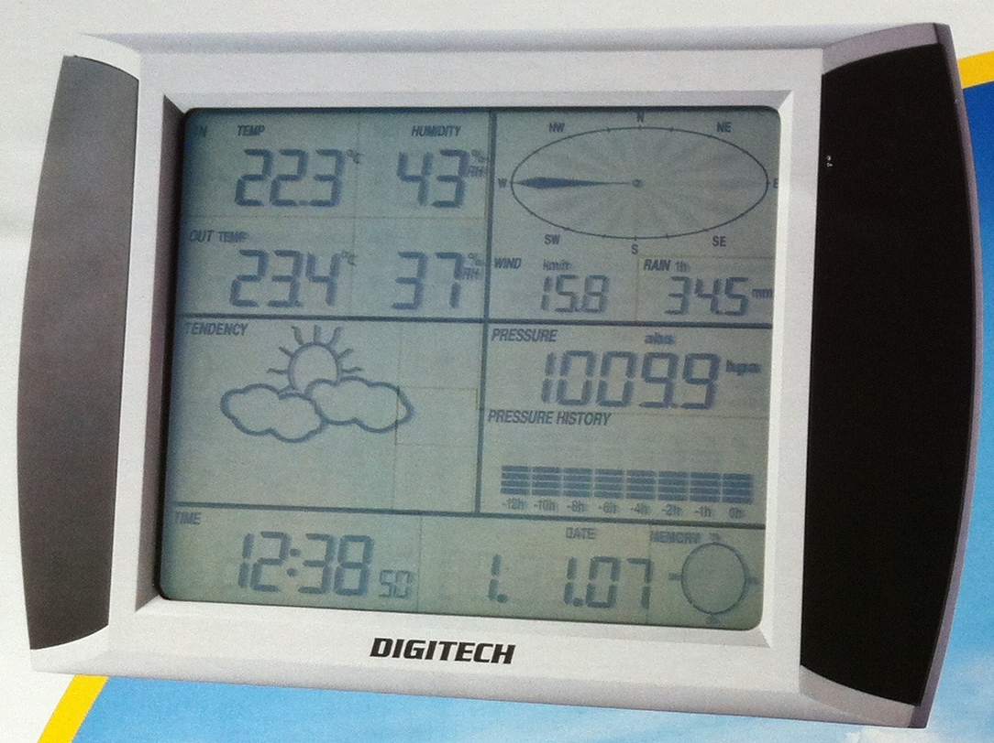
Base Unit
Inside temp / humidity
Wind direction
Outside temp / humidity
Wind speed
Rain
Magic
Air pressure
Magic
Current Time / Date
Memory usage

Slide 8
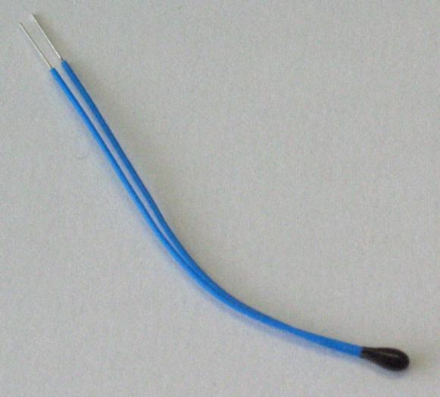
Thermometer
Thermistor
The relationship between resistance and temperature is (1st order) linear
ΔR=kΔT
k = temperature coefficient of resistance
If we know R at a given temperature, and we know k then we can solve for T.
The weather station is accurate to 0.1°C For more accuracy (0.02° over 200°C range) the Steinhart–Hart equation is used:
1/T = A+B ln(R)+C(ln(R))³
http://en.wikipedia.org/wiki/Thermistor

Slide 9
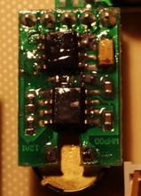
Hygrometer
Probably a capacitive humistor
The dielectric plate of a capacitor is made from a material that absorbs moisture and releases it into the capacitor thus changing its capacitive behavior
To measure humidity, measure the capacitance of the device
Modern versions come on a chip that does all the hard work

Slide 10
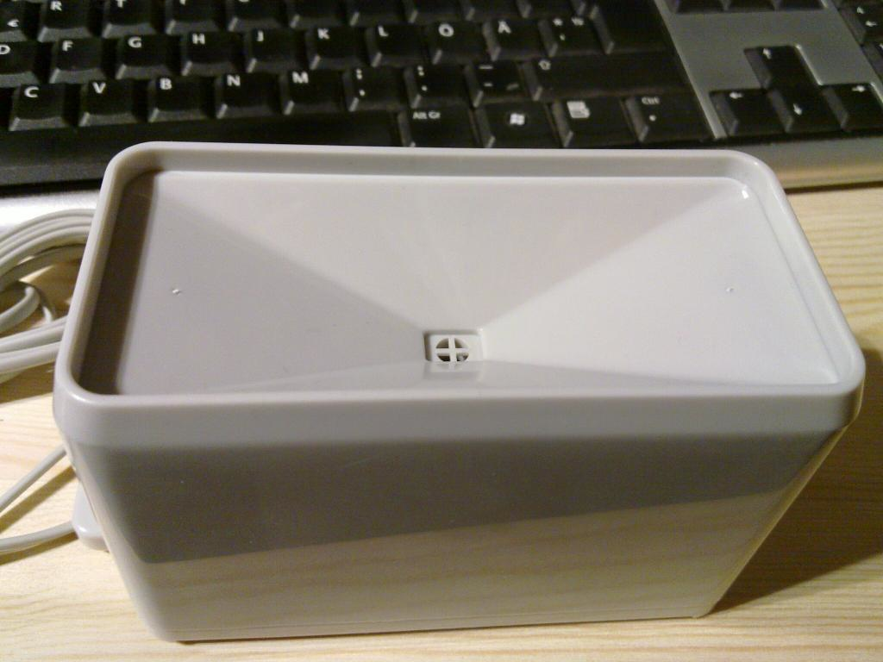
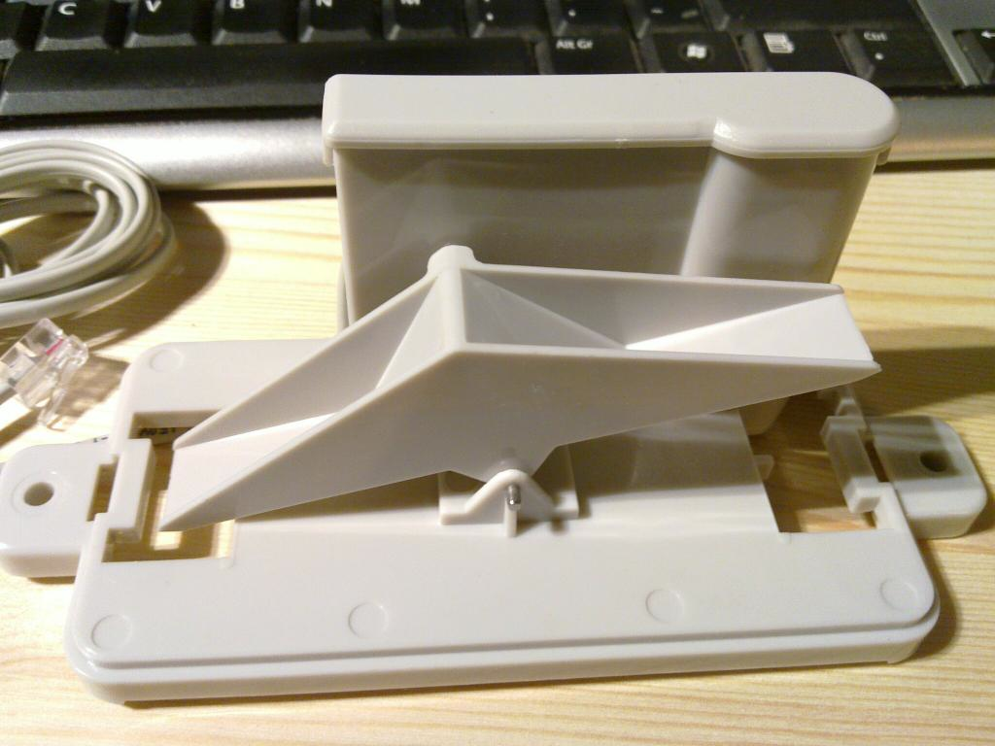
Pluviometer
Simple bucket-tipping seesaw mechanism. Each 0.2794 mm of rain causes a tip.
Each “tip” sends a magnet past a reed switch
A microcontroller counts “ticks”
http://bsd.ee/~hadara/blog/?paged=2
http://bsd.ee/~hadara/blog/?paged=2

Slide 11
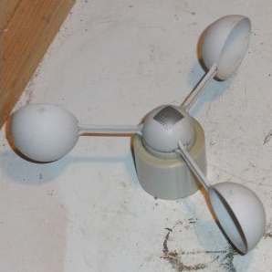
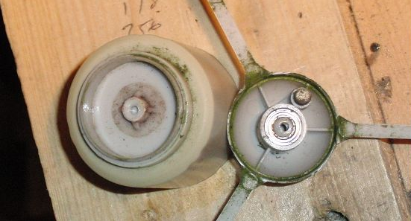
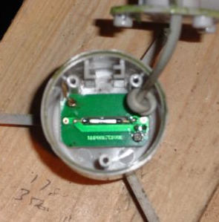
Anemometer
As the cups rotate a magnet passes a reed switch and creates a pulse. A microcontroller counts pulses per second. This board (apparently) pulses twice per rotation.
http://www.digitalham.co.uk/weather/equipment/watson-w8681/wind-speed/

Slide 12
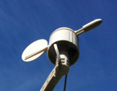
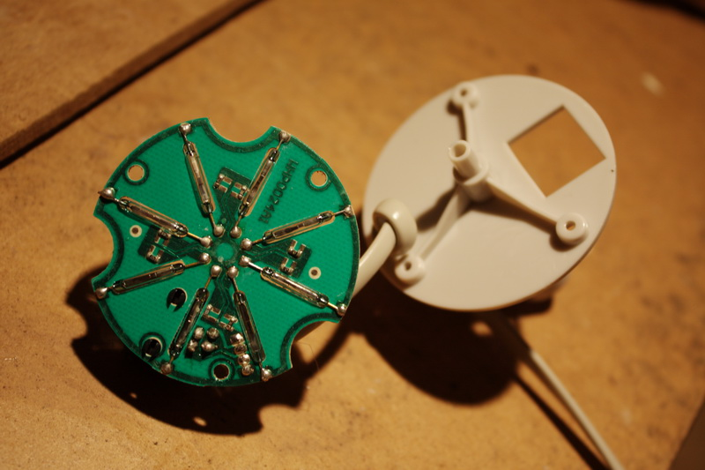
Vane
Digital to analog converter
Reed switches arranged in an octagon
The magnet is on the “pointer”
When the wind blows at most two switches close
Each switch is connected to a different ohm resister
Measure the voltage drop of the circuit to get direction
http://sandaysoft.com/forum/viewtopic.php?f=13&t=492&start=15

Slide 13
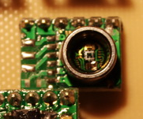
Barometer
Located in the base station
Piezoresistive
As the pressure changes the resistivity changes
http://sandaysoft.com/forum/viewtopic.php?f=4&p=5391

Slide 14
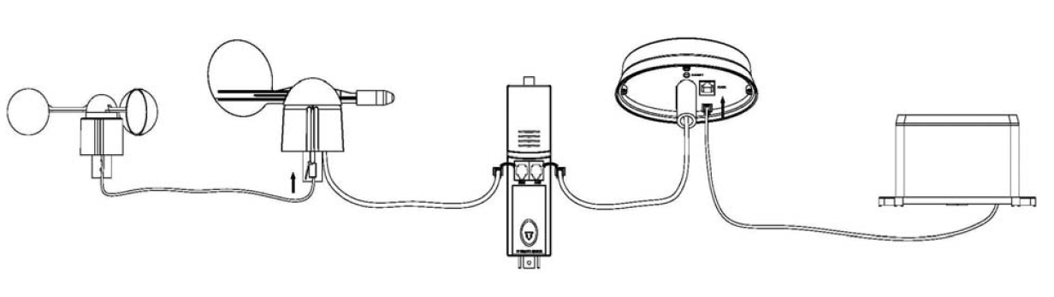
Wire It Up

Slide 15
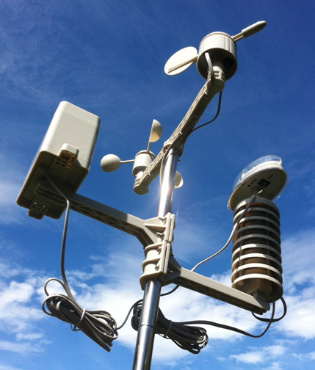
Screw It Up

Slide 16
Protocols
10 byte packet sent every 48 seconds at 433 MHz
Device identifier
Temperature
Humidity
Average wind speed
Gust wind speed
Rainfall counter
Battery indicator
Wind direction
Checksum

Slide 17
Base Station

Slide 18
PC Software

Slide 19
What’s The Problem?
When do you want to know the temperature
From where?
On what device?
What do you want to know?

